Slide 1
Online Bus Ticket Reservation

Slide 2
Table of Content
Introduction
Problem statement
Scope
Activity Diagram
Conclusion

Slide 3
Introduction:
Online Bus Ticket Reservation System is Windows based application that works within centralized network. The software program “Online Bus Reservation System” provides bus transportation system, a facility to reserved seats, cancellation of seats and different types of enquiry which need an instant and quick reservation. OBTRS is built for manage and computerize the traditional database, ticket booking and tracking bus and travel made easy. It maintains all data of users, bus details, reservation details, booking details, customer details.

Slide 4
Problem Statement
Currently, the type of system being used at the counter is an analog system which is manually used in selling the bus tickets. The problems facing the company are that customers have to go to the counter to buy bus ticket or ask for bus schedule, customers will also have to queue up for a long time in order to secure a bus ticket .

Slide 5
Scope
The scope of the online bus ticket reservation is:
A person should be able to
Login to the system through the first page of the application
Change the password after login into the system
Should be able to create a new login for accessing the reservation facility.
No reservation before Two days can be done.
Able To choose the seats which are available for a certain class
Give details about the credit card
Improved & optimized service.

Slide 6
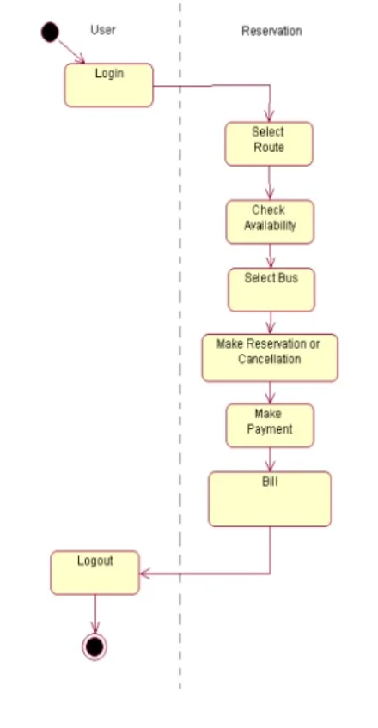
Activity Diagram

Slide 7
Conclusion
The method to solve this problem is to create an online booking bus ticket system . Customer can buy the book ticket over the Internet, 24 hours a day, 7 days a week and the bus ticket can't be lost, stolen or left behind. In addition, the online system lets the customers check the availability of the bus ticket before they buy bus ticket. Furthermore, customers no need to pay cash to buy bus ticket because they can pay the bus ticket on the traveling time.

Slide 8
Thank You

